Slide 1
Arrays

Slide 2
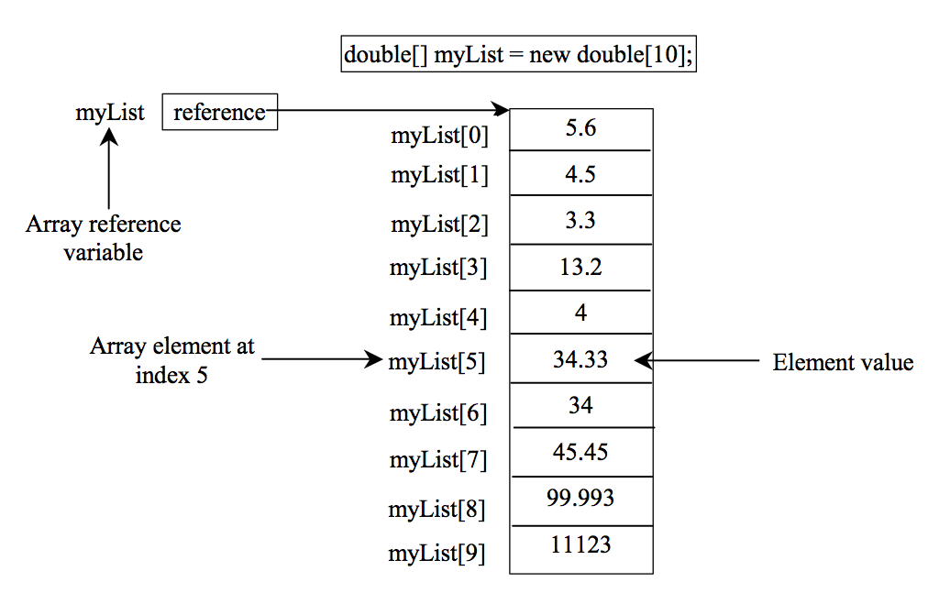
Introducing Arrays
Array is a data structure that represents a collection of the same types of data.

Slide 3
Declaring Array Variables
datatype[] arrayRefVar;
Example:
double[] myList;
datatype arrayRefVar[]; // This style is allowed, but not preferred
Example:
double myList[];

Slide 4
Creating Arrays
arrayRefVar = new datatype[arraySize];
Example:
myList = new double[10];
myList[0] references the first element in the array.
myList[9] references the last element in the array.

Slide 5
Declaring and Creating in One Step
datatype[] var = new datatype[arraySize];
Example:
double[] myList = new double[10];

Slide 6
The Length of an Array
Once an array is created, its size is fixed. It cannot be changed. You can find its size using
var.length
For example,
myList.length outputs 10

Slide 7
Default Values
When an array is created, its elements are assigned the default value of
0 for the numeric primitive data types,
'\u0000' for char types, and
false for boolean types.

Slide 8
Indexed Variables
The array elements are accessed through the index. The array indices are 0-based, i.e., it starts from 0 to var.length-1.
Each element in the array is represented using the following syntax, known as an indexed variable:
var[index];

Slide 9
Using Indexed Variables
After an array is created, an indexed variable can be used in the same way as a regular variable. For example, the following code adds the value in myList[0] and myList[1] to myList[2].
myList[2] = myList[0] + myList[1];

Slide 10
Array Initializers
Declaring, creating, initializing in one step:
double[] myList = {1.9, 2.9, 3.4, 3.5};
This shorthand syntax must be in one statement.

Slide 11
Declaring, creating, initializing Using the Shorthand Notation
double[] myList = {1.9, 2.9, 3.4, 3.5};
This shorthand notation is equivalent to the following statements:
double[] myList = new double[4];
myList[0] = 1.9;
myList[1] = 2.9;
myList[2] = 3.4;
myList[3] = 3.5;

Slide 12
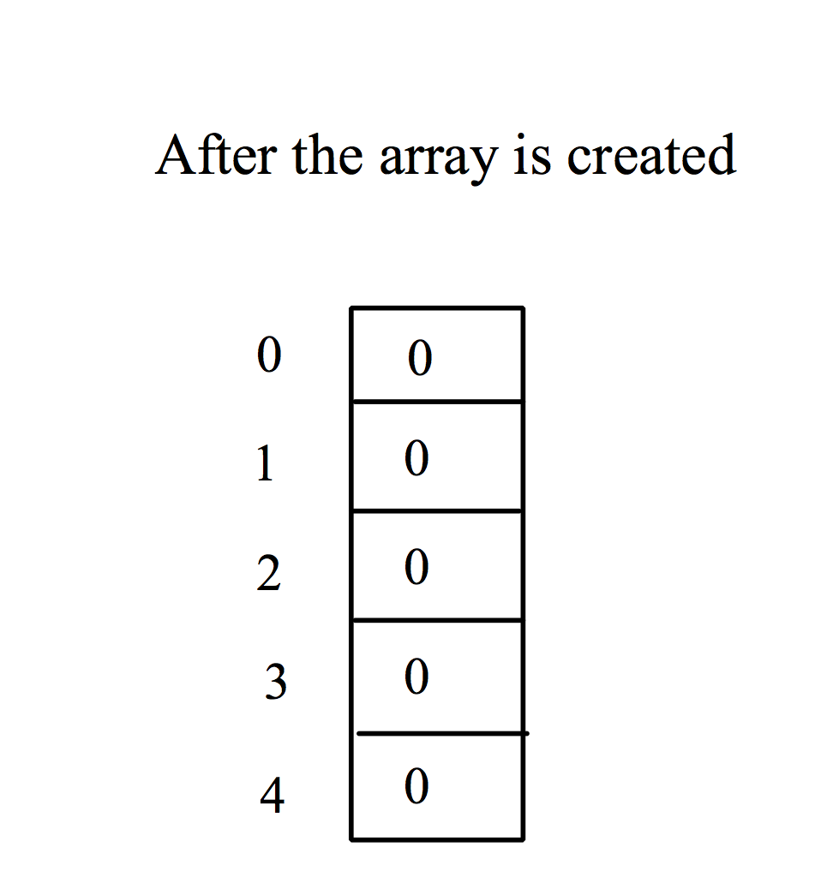
Trace Program with Arrays
animation
Declare array variable values, create an array, and assign its reference to values
public class Test {
public static void main(String[] args) {
int[] values = new int[5];
for (int i = 1; i < 5; i++) {
values[i] = i + values[i-1];
}
values[0] = values[1] + values[4];
}
}

Slide 13
Trace Program with Arrays
animation
i becomes 1
public class Test {
public static void main(String[] args) {
int[] values = new int[5];
for (int i = 1; i < 5; i++) {
values[i] = i + values[i-1];
}
values[0] = values[1] + values[4];
}
}

Slide 14
Trace Program with Arrays
animation
i (=1) is less than 5
public class Test {
public static void main(String[] args) {
int[] values = new int[5];
for (int i = 1; i < 5; i++) {
values[i] = i + values[i-1];
}
values[0] = values[1] + values[4];
}
}

Slide 15

Trace Program with Arrays
animation
After this line is executed, value[1] is 1
public class Test {
public static void main(String[] args) {
int[] values = new int[5];
for (int i = 1; i < 5; i++) {
values[i] = i + values[i-1];
}
values[0] = values[1] + values[4];
}
}

Slide 16
Trace Program with Arrays
animation
After i++, i becomes 2
public class Test {
public static void main(String[] args) {
int[] values = new int[5];
for (int i = 1; i < 5; i++) {
values[i] = i + values[i-1];
}
values[0] = values[1] + values[4];
}
}

Slide 17
Trace Program with Arrays
animation
i (= 2) is less than 5
public class Test {
public static void main(String[] args) {
int[] values = new int[5];
for (int i = 1; i < 5; i++) {
values[i] = i + values[i-1];
}
values[0] = values[1] + values[4];
}
}

Slide 18

Trace Program with Arrays
animation
After this line is executed,
values[2] is 3 (2 + 1)
public class Test {
public static void main(String[] args) {
int[] values = new int[5];
for (int i = 1; i < 5; i++) {
values[i] = i + values[i-1];
}
values[0] = values[1] + values[4];
}
}

Slide 19
Trace Program with Arrays
animation
After this, i becomes 3.
public class Test {
public static void main(String[] args) {
int[] values = new int[5];
for (int i = 1; i < 5; i++) {
values[i] = i + values[i-1];
}
values[0] = values[1] + values[4];
}
}

Slide 20
Trace Program with Arrays
animation
i (=3) is still less than 5.
public class Test {
public static void main(String[] args) {
int[] values = new int[5];
for (int i = 1; i < 5; i++) {
values[i] = i + values[i-1];
}
values[0] = values[1] + values[4];
}
}

Slide 21

Trace Program with Arrays
animation
After this line, values[3] becomes 6 (3 + 3)
public class Test {
public static void main(String[] args) {
int[] values = new int[5];
for (int i = 1; i < 5; i++) {
values[i] = i + values[i-1];
}
values[0] = values[1] + values[4];
}
}

Slide 22
Trace Program with Arrays
animation
After this, i becomes 4
public class Test {
public static void main(String[] args) {
int[] values = new int[5];
for (int i = 1; i < 5; i++) {
values[i] = i + values[i-1];
}
values[0] = values[1] + values[4];
}
}

Slide 23
Trace Program with Arrays
animation
i (=4) is still less than 5
public class Test {
public static void main(String[] args) {
int[] values = new int[5];
for (int i = 1; i < 5; i++) {
values[i] = i + values[i-1];
}
values[0] = values[1] + values[4];
}
}

Slide 24

Trace Program with Arrays
animation
After this, values[4] becomes 10 (4 + 6)
public class Test {
public static void main(String[] args) {
int[] values = new int[5];
for (int i = 1; i < 5; i++) {
values[i] = i + values[i-1];
}
values[0] = values[1] + values[4];
}
}

Slide 25
Trace Program with Arrays
animation
After i++, i becomes 5
public class Test {
public static void main(String[] args) {
int[] values = new int[5];
for (int i = 1; i < 5; i++) {
values[i] = i + values[i-1];
}
values[0] = values[1] + values[4];
}
}

Slide 26
Trace Program with Arrays
animation
i ( =5) < 5 is false. Exit the loop
public class Test {
public static void main(String[] args) {
int[] values = new int[5];
for (int i = 1; i < 5; i++) {
values[i] = i + values[i-1];
}
values[0] = values[1] + values[4];
}
}

Slide 27
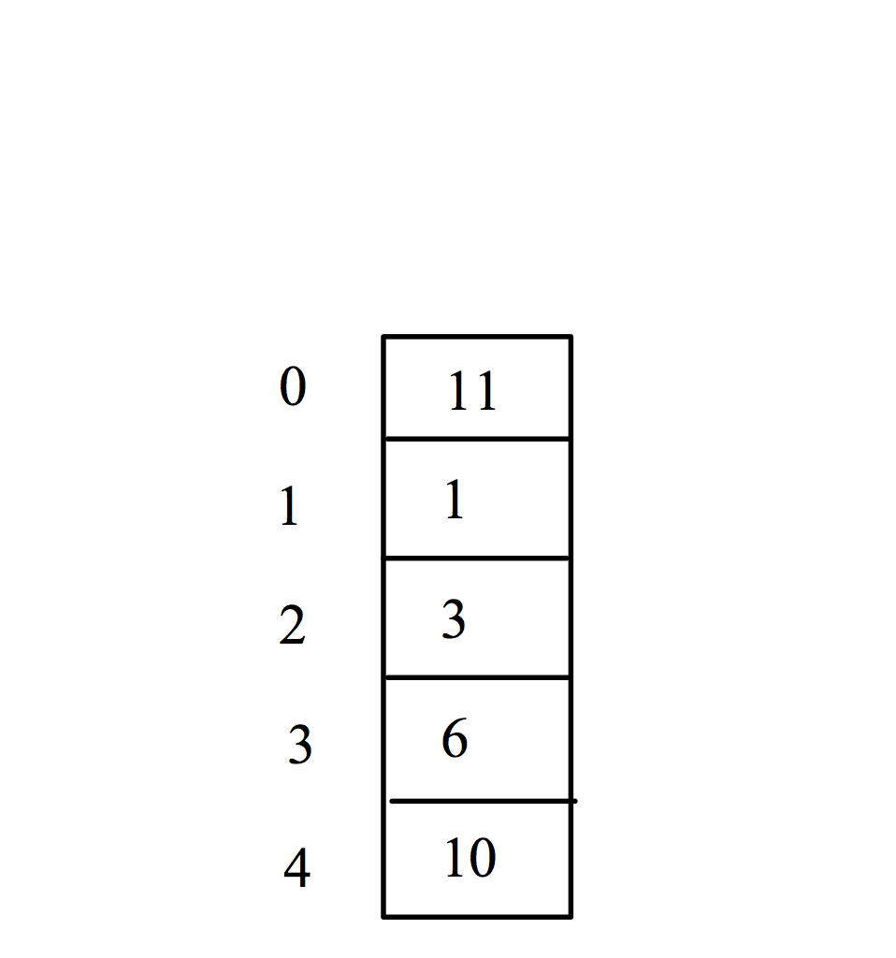
Trace Program with Arrays
animation
After this line, values[0] is 11 (1 + 10)
public class Test {
public static void main(String[] args) {
int[] values = new int[5];
for (int i = 1; i < 5; i++) {
values[i] = i + values[i-1];
}
values[0] = values[1] + values[4];
}
}

Slide 28
Printing arrays
for (int i = 0; i < myList.length; i++) {
System.out.print(myList[i] + " ");
}

Slide 29
Summing all elements
double total = 0;
for (int i = 0; i < myList.length; i++) {
total += myList[i];
}

Slide 30
Searching Array
/** The method for finding a key in the list */
public static int linearSearch(int[] list, int key) {
for (int i = 0; i < list.length; i++)
if (key == list[i])
return i;
return -1;
}
Trace the method
int[] list = {1, 4, 4, 2, 5, -3, 6, 2};
int i = linearSearch(list, 4); // returns 1
int j = linearSearch(list, -4); // returns -1
int k = linearSearch(list, -3); // returns 5

Slide 31
Copying Arrays
Using a loop:
int[] sourceArray = {2, 3, 1, 5, 10};
int[] targetArray = new int[sourceArray.length];
for (int i = 0; i < sourceArrays.length; i++)
targetArray[i] = sourceArray[i];

Slide 32
Assignment 1 (a)
Write a method ‘reverse’ in Java to reverse the content of an array.
Example:
int[] list1 = {1, 2, 3, 4, 5, 6};
int[] list2 = {78, 65, 98};
int[] list3 = reverse(list1);
int[] list4 = reverse(list2);
After the execution of the above code, the contents of list3 and list4 should be {6, 5, 4, 3, 2, 1} and {98, 65, 78}.

Slide 33
Multidimensional Arrays

Slide 34
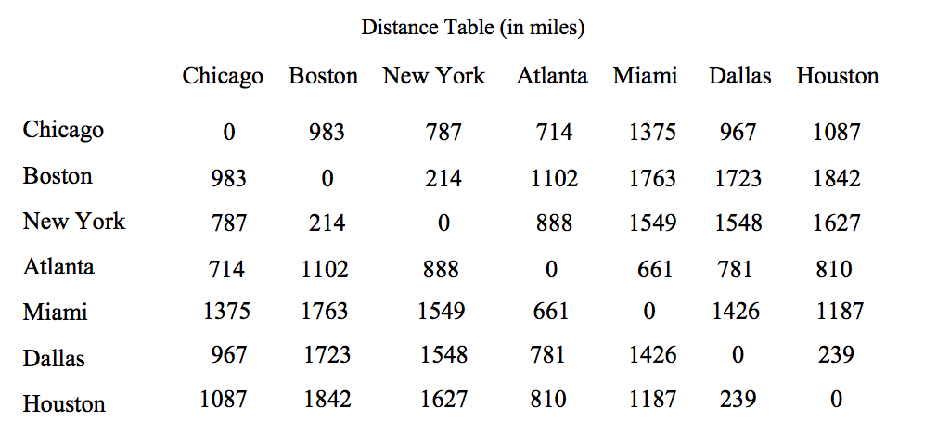
Motivations
Thus far, you have used one-dimensional arrays to model linear collections of elements. You can use a two-dimensional array to represent a matrix or a table. For example, the following table that describes the distances between the cities can be represented using a two-dimensional array.

Slide 35
Declare/Create Two-dimensional Arrays
// Declare array ref var
dataType[][] refVar;
// Create array and assign its reference to variable
refVar = new dataType[10][10];
// Combine declaration and creation in one statement
dataType[][] refVar = new dataType[10][10];
// Alternative syntax
dataType refVar[][] = new dataType[10][10];

Slide 36
Declaring Variables of Two-dimensional Arrays and Creating Two-dimensional Arrays
int[][] matrix = new int[10][10];
or
int matrix[][] = new int[10][10];
for (int i = 0; i < matrix.length; i++)
for (int j = 0; j < matrix[i].length; j++)
matrix[i][j] = i*j;

Slide 37
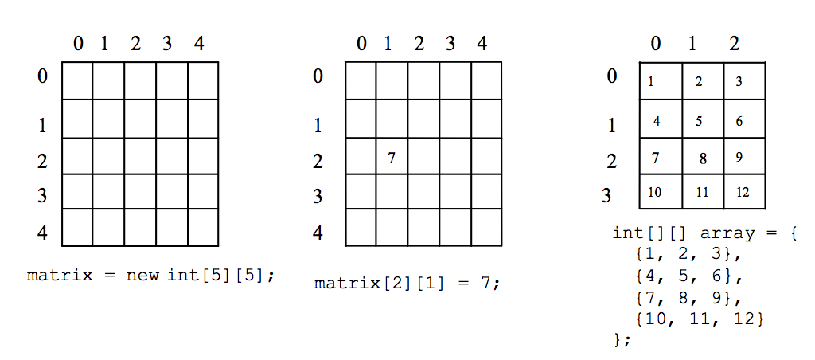
Two-dimensional Array Illustration
matrix.length? 5
matrix[0].length? 5
array.length? 4
array[0].length? 3

Slide 38
Declaring, Creating, and Initializing Using Shorthand Notations
You can also use an array initializer to declare, create and initialize a two-dimensional array. For example,
int[][] array = {
{1, 2, 3},
{4, 5, 6},
{7, 8, 9},
{10, 11, 12}
};
int[][] array = new int[4][3];
array[0][0] = 1; array[0][1] = 2; array[0][2] = 3;
array[1][0] = 4; array[1][1] = 5; array[1][2] = 6;
array[2][0] = 7; array[2][1] = 8; array[2][2] = 9;
array[3][0] = 10; array[3][1] = 11; array[3][2] = 12;
Same as

Slide 39
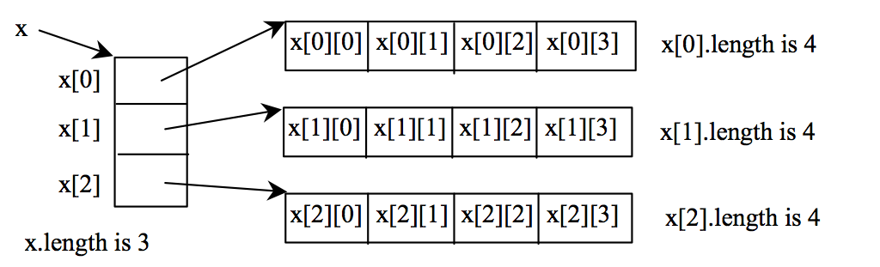
Lengths of Two-dimensional Arrays
int[][] x = new int[3][4];

Slide 40
Lengths of Two-dimensional Arrays, cont.
int[][] array = {
{1, 2, 3},
{4, 5, 6},
{7, 8, 9},
{10, 11, 12}
};
array.length
array[0].length
array[1].length
array[2].length
array[3].length
array[4].length ArrayIndexOutOfBoundsException

Slide 41
Initializing arrays with random values
for (int row = 0; row < matrix.length; row++) {
for (int column = 0; column < matrix[row].length; column++) {
matrix[row][column] = (int)(Math.random() * 100);
}
}

Slide 42
Printing arrays
for (int row = 0; row < matrix.length; row++) {
for (int column = 0; column < matrix[row].length; column++) {
System.out.print(matrix[row][column] + " ");
}
System.out.println();
}

Slide 43
Summing all elements
int total = 0;
for (int row = 0; row < matrix.length; row++) {
for (int column = 0; column < matrix[row].length; column++) {
total += matrix[row][column];
}
}

Slide 44
Assignment 1 (a)
Write a method ‘reverse’ in Java to reverse the content of an array.
Example:
int[] list1 = {1, 2, 3, 4, 5, 6};
int[] list2 = {78, 65, 98};
int[] list3 = reverse(list1);
int[] list4 = reverse(list2);
After the execution of the above code, the contents of list3 and list4 should be {6, 5, 4, 3, 2, 1} and {98, 65, 78}.

Slide 45
Assignment 1 (b)
Write a program in java to calculate sum of the elements of a column of a two-dimensional array.
Example:
int[][] array = {
{1, 2, 3},
{4, 5, 6},
{7, 8, 9},
{10, 11, 12}
};
Output:
Sum for column 0 is 22
Sum for column 1 is 26
Sum for column 2 is 30

Slide 46
Assignment 1 (a & b)
Solve the problem and execute the code first. Then, submit the handwritten version of the code no later than the next Sunday.

